Slide 1

Schema in databases
In MySQL, schema is synonymous of database.
A schema is a collection of database objects including tables, views, triggers, stored procedures, indexes, etc. A schema is associated with a username which is known as the schema owner, who is the owner of the logically related database objects.
Infoway Technologies, 3rd Floor Commerce Centre, Rambaug Colony, Paud Road Pune 411038

Slide 2
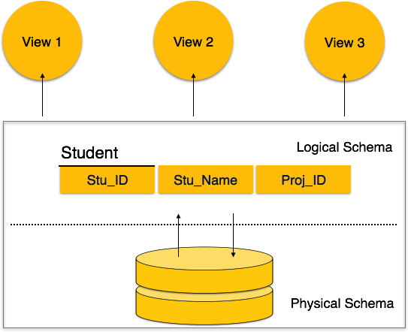
Schema
A database schema can be divided broadly into two categories −
Physical Database Schema − This schema is related to the actual storage of data and its form of storage like files. It defines how the data will be stored in a secondary storage.
Logical Database Schema − This schema defines all the logical constraints that need to be applied on the data stored. It defines tables, views, and integrity constraints.
Infoway Technologies, 3rd Floor Commerce Centre, Rambaug Colony, Paud Road Pune 411038

Slide 3
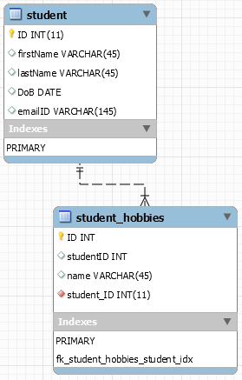
Schema
CREATE TABLE student (
ID INT(11) PRIMARY KEY,
firstName VARCHAR(45),
lastName VARCHAR(45),
DoB DATE,
emailID VARCHAR(145)
);
CREATE TABLE student_hobbies (
ID INT PRIMARY KEY,
studentID INT,
name VARCHAR(45),
FOREIGN KEY (studentID) REFERENCES student(ID)
);
Infoway Technologies, 3rd Floor Commerce Centre, Rambaug Colony, Paud Road Pune 411038

Slide 4
Create schema/database
To create a new database in MySQL, you use the CREATE DATABASE statement with the following syntax:
CREATE {DATABASE | SCHEMA} [IF NOT EXISTS] db_name
e.g.
CREATE SCHEMA IF NOT EXISTS myDB;
CREATE DATABASE IF NOT EXISTS myDB;
To select a particular database to work with you issue the USE statement with the follows syntax :
USE db_name
The USE statement tells MySQL to use the named database as the default (current) database for subsequent statements. The named database remains the default until the end of the session or another USE statement is issued.
e.g.
USE myDB;
Note: Moving objects from one schema to another schema in MySQL is not possible
Infoway Technologies, 3rd Floor Commerce Centre, Rambaug Colony, Paud Road Pune 411038

Slide 5
Schema
A database schema is the skeleton structure that represents the logical view of the entire database. It defines how the data is organized and how the relations among them are associated.
A database schema can be divided broadly into two categories −
Physical Database Schema − This schema is related to the actual storage of data and its form of storage like files. It defines how the data will be stored in a secondary storage.
Logical Database Schema − This schema defines all the logical constraints that need to be applied on the data stored. It defines tables, views, and integrity constraints.
Infoway Technologies, 3rd Floor Commerce Centre, Rambaug Colony, Paud Road Pune 411038

